Slide 1
The Good Shepherd
John 10:1-20

Slide 2
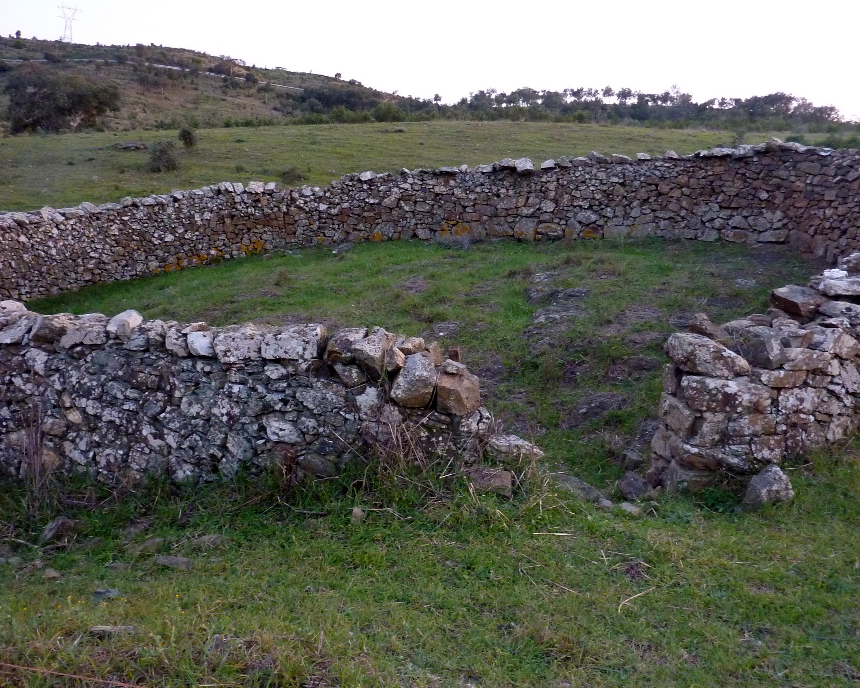
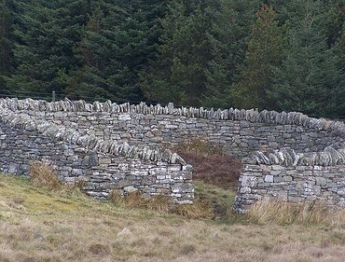
Ancient Sheep Fold

Slide 3
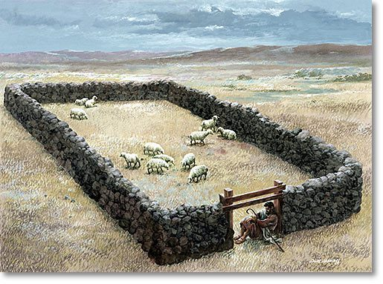
Shepherd guarding the sheep

Slide 4
“I am the door; whoever enters through me, he will be saved”
John 14:6 Jesus is The Way
Acts 4:10-12 Salvation in no one else
I John 5:11-12 life is in the Son

Slide 5
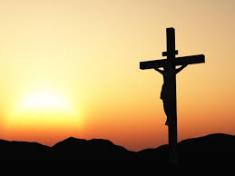
lays down His life for the sheep
Hebrews 10:8-10-offering of Jesus Christ
Romans 6:1-11 dies to sin once for all

Slide 6
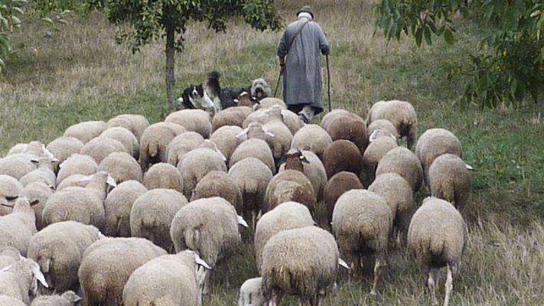
“he calls his own sheep by name”
Saying “It’s all about who you know”
II Timothy 2:19 Lord knows those that are His
Matthew 7:21-23 How are we His?

Slide 7
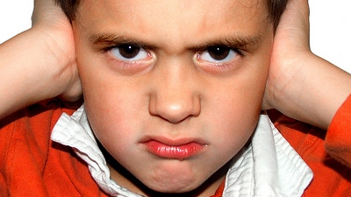
“they did not understand”
Verse 6 and 19
Matthew 13:10-17 nor do they understand
Acts 28:23-29 Paul quotes Isaiah as well
Hebrews 5:11 dull of hearing

Slide 8
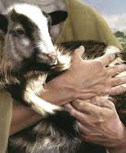
Do we understand
Jesus laid down his life for us. The perfect sacrifice for our sins
Through Jesus” the door” we can enter the eternal kingdom
We are known by Him through our obedience to His will
Jesus “our shepherd” will lead us to eternal life in Heaven
If you understand these things what is your answer to His call?

Slide 9

John 10:27-30
My sheep hear My voice, and I know them, and they follow Me; ²⁸ and I give eternal life to them, and they will never perish; and no one will snatch them out of My hand. ²⁹ My Father, who has given them to Me, is greater than all; and no one is able to snatch them out of the Father’s hand. ³⁰ I and the Father are one.”

