Slide 1
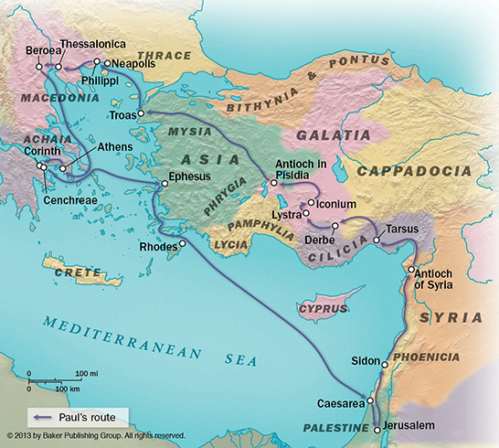
Paul’s
Second
Journey
Notes:
Acts 17.2-3: Came to Thessalonica and was his custom reasoned (explaining and giving evidence) with them from the Scriptures. But, the Jews became jealous, and the brethren sent them away by night.
Traveled 50-55 miles along the Egnation way and came to the city of Berea, and upon arriving went to the synagogue.

Slide 2
Acts 17.11 “Now these were more noble-minded than those in Thessalonica, for they received the word with great eagerness, examining the Scriptures daily to see whether these things were so.”
Notes:
I think we understand this is amazing statement made about the Jews of Berea, but it is even more astounding when we consider the reception of the word in Thessalonica. (I Thessalonians 1.2-10) (Could be a comparison just between the Jews, but noteworthy all the same no other church received this accolade.)

Slide 3
Acts 17.11 “Now these were more noble-minded than those in Thessalonica, for they received the word with great eagerness, examining the Scriptures daily to see whether these things were so.”
EUGENES
Notes:
(eugenes from eu = well + genos = family, race) means literally of high or noble birth, but in this context is used figuratively to describe men and women possessing that type of attitude ordinarily associated with well-bred persons. Eugenes is used not only for noble birth but also for noble sentiments, character, morals. The implication is that the Berean Jews were more noble in character than those in Thessalonica in their welcome and cordial treatment of the apostles.
Some translations use the phrase “open-minded.”

Slide 4
Acts 17.11 “Now these were more noble-minded than those in Thessalonica, for they received the word with great eagerness, examining the Scriptures daily to see whether these things were so.”
DECHOMAI
Notes:
Dechomai means to accept deliberately and readily, receive kindly and so to take to oneself what is presented or brought by another. It means to welcome as a teacher, a friend, or a guest into one's house. The word describes accepting persons with open arms, minds, and hearts, even going beyond normally expected gracious hospitality. The term was often used of welcoming honored guests and meeting their needs with special attention and kindness.
They “put-out” the welcome mat.

Slide 5
Acts 17.11 “Now these were more noble-minded than those in Thessalonica, for they received the word with great eagerness, examining the Scriptures daily to see whether these things were so.”
ANAKRINO
Notes:
ANAKRINO from aná = again + kríno = sift, judge, distinguish, separate out so as to investigate) (present tense = continually) means to sift up and down, to examine accurately or carefully (re-examine), to make careful and exact research as in legal processes.To interrogate. To cross-examine. To put through a course of questioning as when one is questioned and examined by a judge in a court of law. It was often used in secular Greek of the interrogation of a prisoner. It was also used of a judicial examination before the final verdict was rendered.

Slide 6
Acts 17.11 “Now these were more noble-minded than those in Thessalonica, for they received the word with great eagerness, examining the Scriptures daily to see whether these things were so.”
“if these things had it thus”
Notes:
They combined receptivity with critical questioning. They wanted ONLY what GOD had said.

Slide 7
Focus On The Wrong Things
Listen To The Wrong Things
Impair Our Own Vision
Galatians 1.6-9; II Corinthians 4.7
I Kings 3.9; Psalm 119.66; Isaiah 11.3-5; Leviticus 10.10; Hosea 14.9
Notes:
Why does it seem they are not more “noble-minded” folks. Why does it seem more folks find themselves in the condition described by Paul in Ephesians 4.14 “…tossed here and there by waves and carried about by every wind of doctrine…?” Why are we?
Focus On The Wrong Things: At times we are tempted to focus more on who says it than what is said. The apostle warns against this specifically.
Listen for the Wrong Things: I am not talking about eloquence or style with this point, but being discerning with what we hear.
Ad Hominem: Using an insult as if it were an argument. (He’s mean…)
Straw Man : Misrepresent an opponents argument as weak to make it easier to critique. (Religion has harmed a lot of people…)
Pray for it (I Kings 3.9; Psalm 119. 66); Jesus (Isaiah 11.3-5); Nothing to Impair (Leviticus 10.10)
Presuppositions: an idea or assumption that a person has before considering additional information. (take-for-granted/we all have them). If we do not set them aside we set up a wall in our thinking. (GOD changes, no hell…)

Slide 8
I Peter 2.2 “…like newborn babies, long for the pure milk of the word, so that by it you may grow in respect to salvation…”
Notes:
I Peter 2.1-3 is a single sentence, but the center of it is the idea of “craving.”
He uses a simile to compare us to newborn babes. Some have suggested all that an infant knows is “desire.”
What causes us to be born again also must continue to feed us. Accept no cheap substitutes.

